Slide 1
Data Analytics
Challenges of Traditional System and Web Data
S.V.Jansi Rani
Assistant Professor / CSE
Notes:
The University of Adelaide, School of Computer Science
Chapter 2 — Instructions: Language of the Computer

Slide 2
Web Data
Cutting edge companies – recency, frequency, monetary value attached to customers
360 degree view –customer – web browser, mobile app, kiosks, social media sites etc…
What are you Missing?
1.7 % of browsing session – purchase
98% web sessions are missing
Traditional web analytics – aggregated behavior and summarized –envmt
Beyond click through reports and page view summaries
Customer level web behavior with other cross-channel customer data

Slide 3
Challenges in Traditional data
Data redundancy & inconsistency
Difficulty in accessing required data
Data Isolation
Integrity Problems
Security problems
Concurrent-access anomalies

Slide 4
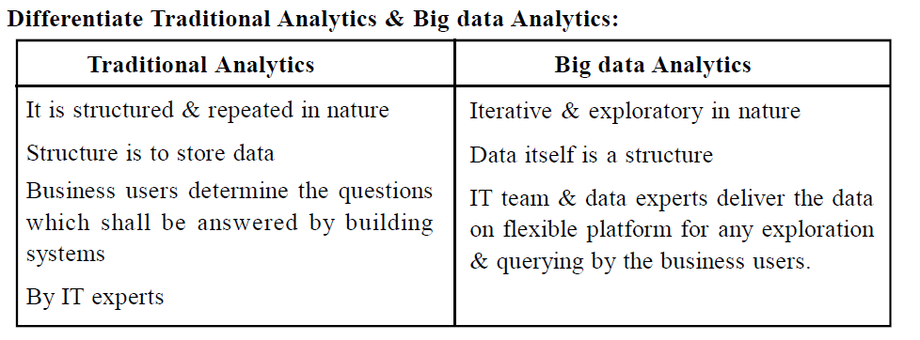

Slide 5
Web Data is a game-changing, amazing new frontier that can revolutionize organization’s customer insights and the impacts those insights have on their buisness

Slide 6
Web Data
Imagine the possibilities – not buying, key decision criteria
Reveals
  shopping behavior – make them to buy right product
  Customer purchase paths and preferences
  Research Behaviors
  Feedback Behaviors

Slide 7
Web Data in Action
Next best offer
Example
He has four accounts: checking, savings,cc, car loan
He make five deposits and 25 withdrawals per month\
He never visits a branch in person
He owes a total of Rs.15,000 for cc and car loan
He has total of Rs.50,000 in assets deposited
What is your inference from this ??????????????

Slide 8
He browsed mortgage rates fives times in past month
He viewed information about homeowners insurance
He viewed information about flood insurance
He explored home loan options twice in past months

Slide 9
Web Data in Action
Attrition Modeling
Churn model – risk of cancelling -> telecomm
Find out customer action in reseraching before cancelling
Attrition – predicting negative behavior

Slide 10
Response Modeling
Predict the choice a customer – logistic regression
Response or propensity model
RM – predicting positive behavior
Customers – scored and ranked-likelihood of action
Using small no of variables – models defined
Big group – very similar , very low score
Web data – diff such customer –large uplift in score

Slide 11
Web Data in Action
Customer Segmentation
Segment customers
Dreamers – browing behavior
Item in Basket – abandon it

